Slide 1
Exploring Cognitive Services
[ speaker name]
[ speaker contact methods ]
Notes:
Put your details above.
Each slide contains example script in the notes. Once confident with the content, you can use the headings in the notes as cues to ad-lib the content in your own words.

Slide 2
Cognition
the mental action or process of acquiring knowledge and understanding through thought, experience, and the senses
Notes:
So what is Cognition?
Read the quote

Slide 3
What are Cognitive Services?
Cognitive services are a set of APIs that are designed to democratize artificial intelligence by enabling systems to see, hear, speak, understand and interpret our needs using natural methods of communication.
What these services generally do is bring structured semantic data to human knowledge I/O with a degree of confidence
“A picture of Satya Nadella happy”
Image of person
Emotional readings
“x% sure that this person is [highest emotion]”
This is about a person
Notes:
CLICK
Read/summarize description
CLICK
Read simplified explanation
We want the machine to draw out those semantics and tell us with what degree of confidence, those semantic interpretations are correct. And if we can get some structured data values or entities in and out then even better.
CLICK
For example, an application may be able to convert spoken language into text, figure out that the query is about a person, find an image of the person, then perhaps also figure out the degree to which various expressions appear in the image and finally speak the confidence of the strongest emotion present

Slide 4
Demo
Introducing Cognitive Services
Notes:
See Demo 1.1
Let’s take a quick look at where you can find the services, and how you can easily give them a go.
Give this URL to the audience so they can try the last demo service – sentiment for a few minutes
https://aka.ms/trysentiment

Slide 5
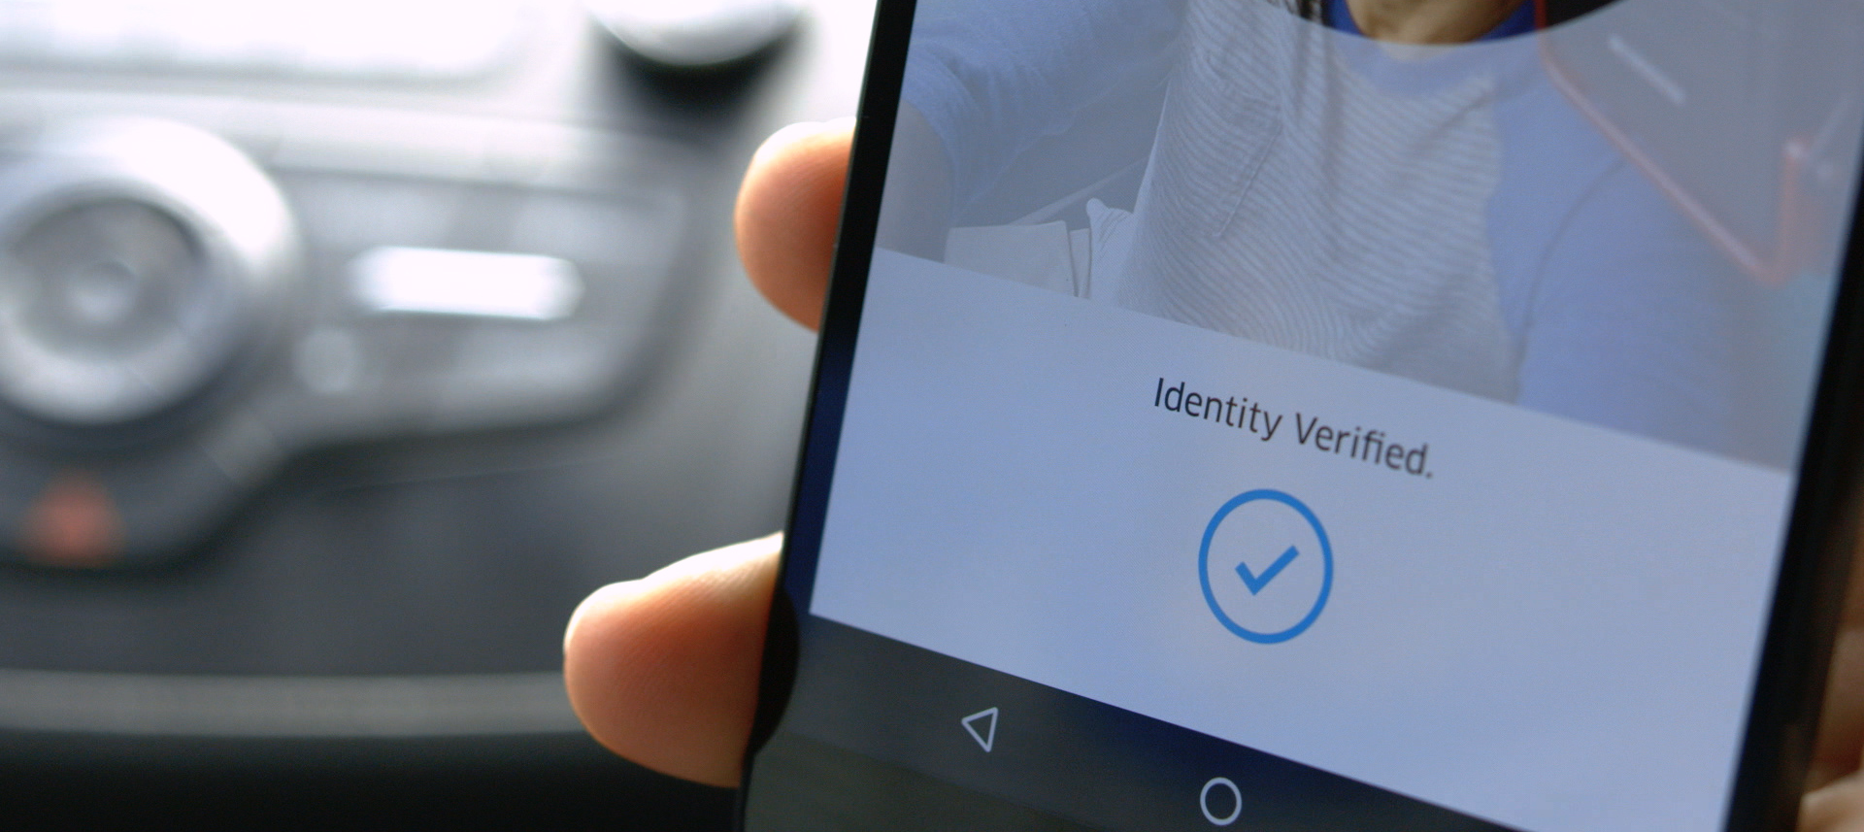

Case Study
The “push a button, get a ride” service in more than 66 countries and 508 cities worldwide, and employs 6,700 people
Drivers take a selfie periodically to check identity
Compares photos with varying pose, focus, and lighting conditions, which is critical for uncontrolled conditions like drivers taking selfies at night in their cars
Match within milliseconds
Thousands of sign-ins every hour
Integrated with Java front-end and Go backend (with Python) in 3 weeks.
Notes:
https://www.microsoft.com/cognitive-services/en-us/applications
CLICK
If you haven’t heard of Uber, it’s the “push a button to get a ride” service that’s sweeping across the globe, into 66 countries and 508 cities, demoncratizing the ride service industry.
CLICK
In order to increase the security of driver revenues and the personal security of passengers, Uber wanted to ensure that the identity of drives was established. Every so often the driver using Uber drive app, has to take a selfie. This means that when passengers request a ride and see the tiny picture of the driver in the corner, they can be confident that the driver operating the app in the car, is the right person
CLICK
The Cognitive Services for Facial recognition is able to deal with a lot of different lighting conditions. Whether the driver is asked to authenticate with their face in the middle of the night, or in dark and cloud conditions, the system has to still work reliably.
CLICK
If Uber is asking their drivers to go through this step it needs to be something that doesn’t become cumbersome so the facial matching has to happen very quickly.
CLICK
The fast experience for individual drivers needs to scale globally to handle simultaneous authentication processing of thousands of drivers every hour.
CLICK
Within 3 weeks, Uber was able to get everything up and running to their satisfaction, integrating with their existing technology stack.

Slide 6
Types of Services
Vision | Speech | Language | Knowledge | Search
Notes:
The services available break down broadly into these 5 categories bringing together new and existing service offerings under the Cognitive Service umbrella. New services are added, and existing services enhanced over time.

Slide 7
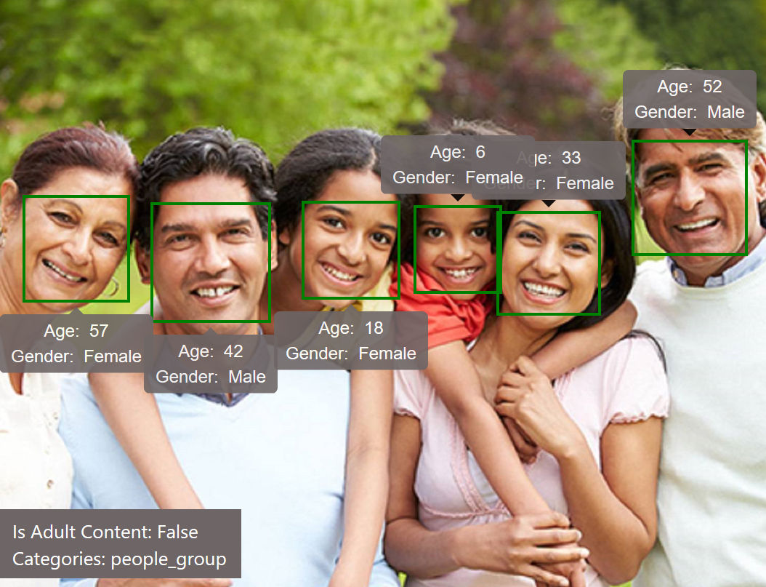
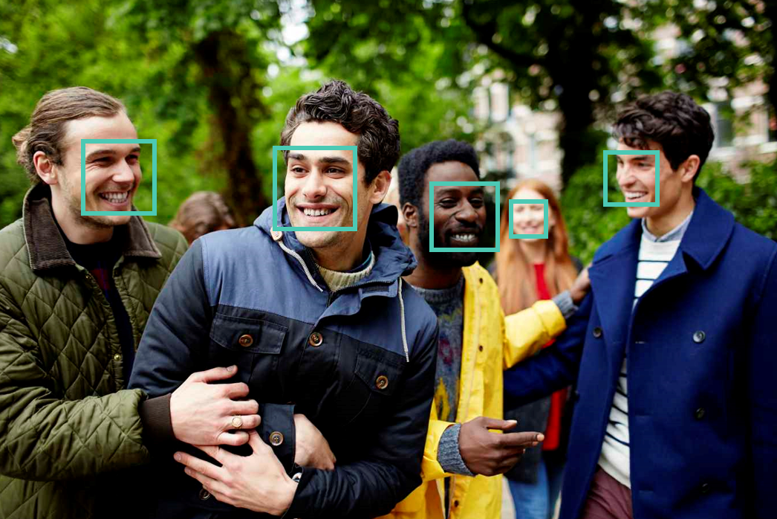
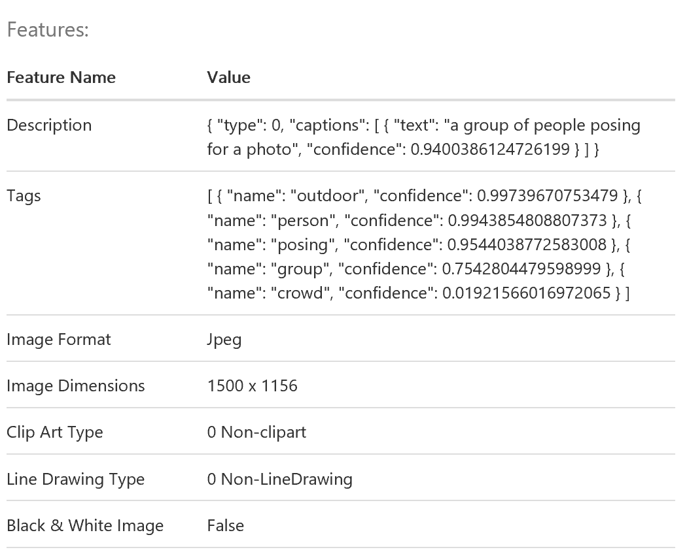
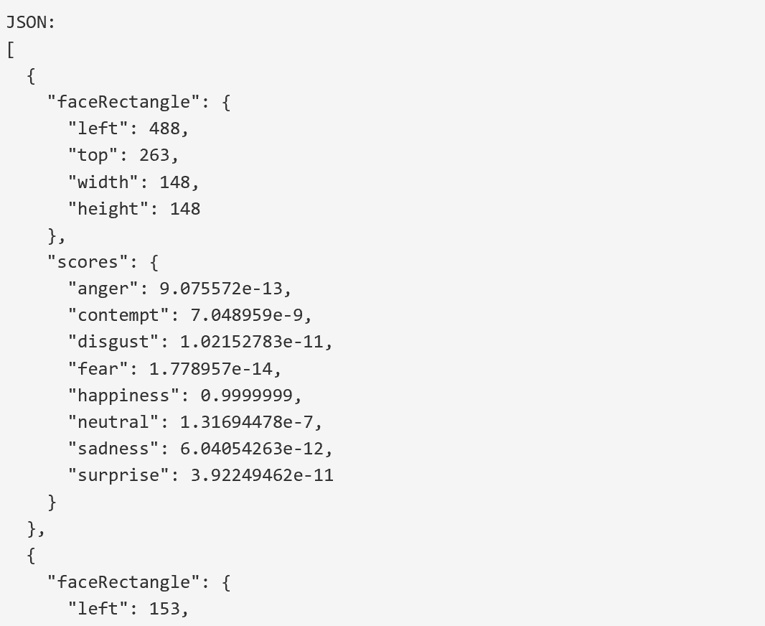
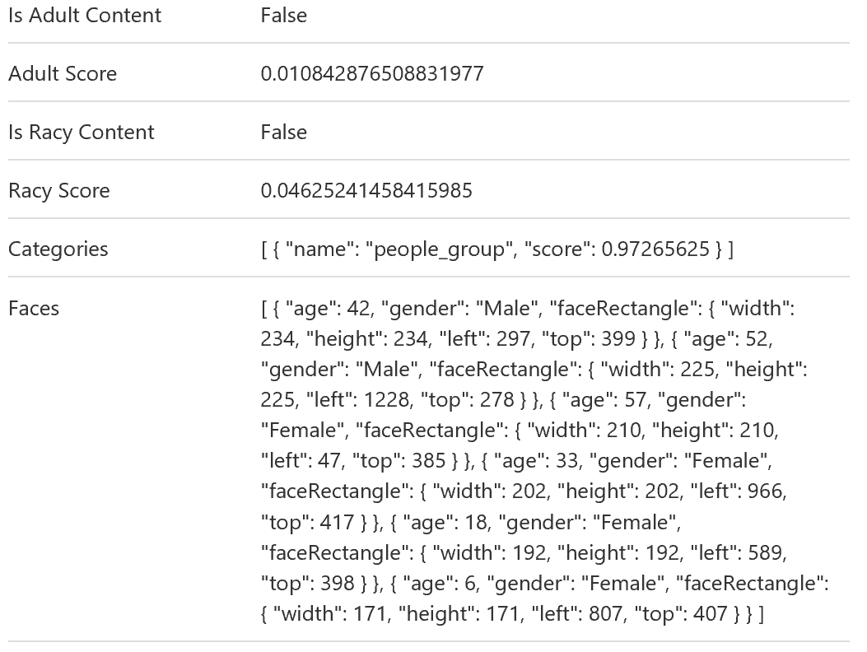
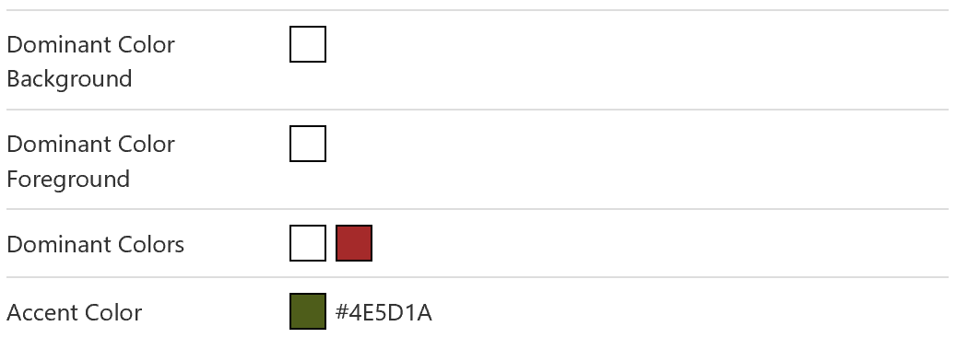
Vision
Computer Vision
Content Moderator
Emotion
Face
Video
Notes:
CLICK – Computer Vision
The computer vision service provides a vast wealth of information from a single picture. In includes a summary description of what it finds in the image, tags for the image content, an assessment of the image type including whether it is adult content, the locations of faces in the picture, including an estimate of the age of each person, and the dominant colors it finds in case you want to adapt an application to match with an image.
CLICK – Content Moderator
Image, video (as well as text moderation) is available to enable you to detect and filter out content undesirable to you individuals, groups or organizations.
CLICK – Emotion
Emotional recognition can be used to enhance many experiences both personal and in business. The Emotion API give you a confidence rating for major emotions after also locating faces in an image.
CLICK - Face
Beyond just emotion machine learning, the Face API can give you information on gender, age, pose orientation, smile and facial hair, along with the position of 27 facial landmarks (for example, eyebrow position, nose position, lips, etc).
CLICK - Video
The video APIs allow you to stabilize video, track multiple faces over time, do motion detection and generate thumbnails. Combine still captures with the other vision service to create a power analytics tool.

Slide 8
Speech
Bing Speech
Custom Speech Engine
Speaker Recognition
Notes:
CLICK – Bing Speech
Bing speech brings speech-to-text to applications allowing you to use voice as a more natural input. The audio can come from a microphone, file or other audio source. Results can be returned in real-time as the audio is sent to the service. Recognition can also be combined with other services. For example, you can get intent of the speaker’s phrase directly from the APIs after some training. And of course there’s also text to speech so your application can respond in kind in a number of languages and voices.
CLICK – Custom Speech Engine
If you are creating a game or a voice interface to a specific tool you’ll want to be sure that domain-specific words and phrases don’t trip up the recognition system. With the Custom Speech Engine, you can create a language model that will assist with the recognition. Not only that but you can create acoustic models that will help with the low quality audio in uncooperative environments. With those made, you can deploy them to a custom recognition end point ready to handle your specific scenario.
CLICK – Speaker Recognition
With Speaker Recognition, your voice is your passport both to authenticate you as an individual (with sample training) and also to identify you amongst a group of known speakers.

Slide 9
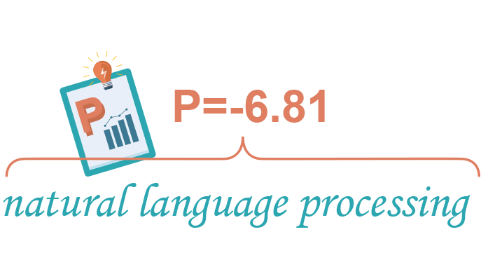
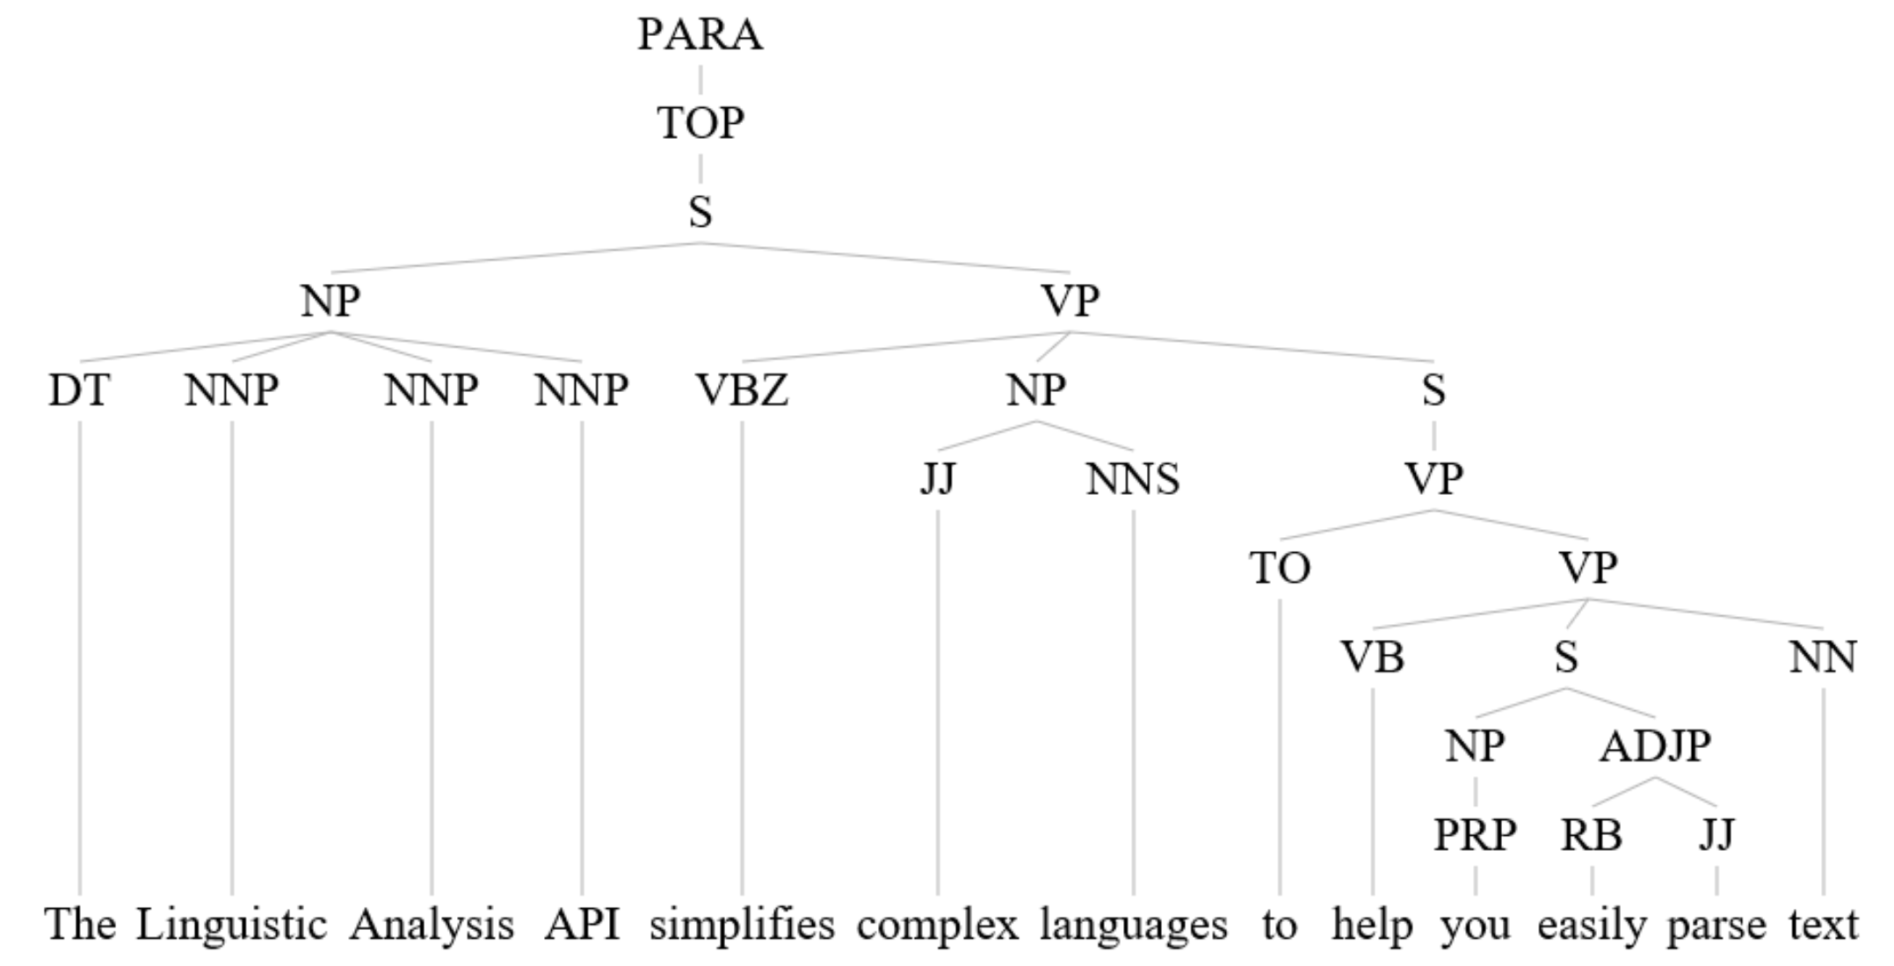
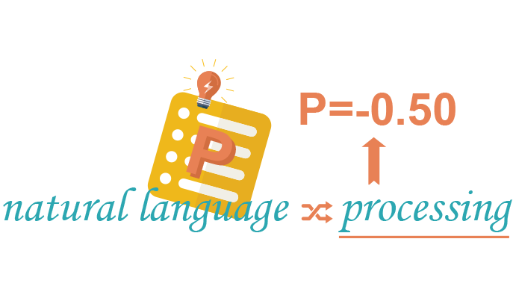

Language
Bing Spell Check
Linguistic Analytics
Text Analytics
Translator
WebLM
Language Understanding
Notes:
CLICK – Spell Check
Bing Spell check provides the power of correction in any application. Call the service with text and select either Proofing (for light document corrections) or Spelling for full-power correction.
CLICK – Linguistic Analytics
If you really want to dig into the structure of a sentence, then Linguistic Analytics gets you a full drill-down tree of the parts of a sentence. If you are building a bot, you may want to use this capabilities.
CLICK – Text Analytics
Beyond structure trees, there’s more summary information in text that you may want to know. You can find out in which language the text was written, which parts of the text are the key phrases andoverall, the sentiment of the text whether positive or negative. For language detection and sentiment, you get a percentage of confidence.
CLICK – Translator
As with Text Analytics you can do automatic language detection, but of course you can do translations. These can be speech translation in 9 languages and text translation in 60 languages. You can improve translation by providing reference dictionary translations and sample sentences. There’s also a collaboration workflow framework allowing contributors to suggest translations and for others to approve a result.
CLICK – WebLM
WebLM provides a series of APIs around the probability of various language sequences based on language modelling. If can do things like split words when spaces have been missed, get the probability of a sequence, the probability of a specific word coming next, and next word suggestions. You may have seen these kinds of things in action when typing on your mobile device’s keyboard.
CLICK – Language Understanding
The Language Understanding Intelligent Service, or LUIS is a key service. The user sets up a series of intentions and provides examples of text that portray that intention. The service is then trained on those samples so that it can then recognize which intention a new arbitrary sentence is portraying. This is great for use in bots, where the bot needs to know what intention or action a user is attempting to perform. The service may also extract specific entities (often nouns) from the text and pass those along too. The service also indicates the confidence with which it determines a specific intent is present.

Slide 10
Knowledge
Academic
Entity Linking
Knowledge Exploration
QnA Maker
Recommendations
Notes:
CLICK - Academic
The Academic APIs draw on knowledge to allow for sophisticated auto-completion experiences by interpreting text and adding annotations, they also do queries against Academic knowledge, returning structured entities, then allow for the return of statistic data around those results, and also allow you to find if two pieces of text are portraying the same concepts and also search for a specific graph pattern.
CLICK – Entity Linking
This API can use recognized entities (about which knowledge can be found, e.g. on Wikipedia) used throughout a piece of text and link together those which are the same, based on context.
CLICK – Knowledge Exploration
Similar to the Academic APIs, these APIs interpret language as structured queries, enable auto-completion, retrieve information about real-world entities, and provide attribute statistics.
CLICK – QnA Maker
This service can be used initially to extract regularly published FAQ Q&As and re-present them as a conversational bot interface or other interactive interface. The underlying model is trained on existing Q&As and can be manually adjusted.
CLICK – Recommendations
Perhaps one of the most heard-about uses of automated knowledge, these APIs can, given a history of data, give suggestions of items previously associated together (perhaps in a store purchase), show other relevant items based on previous users’ activity, or items personalized to the user’s own previous activity.

Slide 11
Search
Bing Autosuggest
Bing Image Search
Bing News Search
Bing Video Search
Bing Web Search
Notes:
CLICK – Autosuggest
Add to your app or website by using Autosuggest on the text a user is typing to help them complete it more quickly
CLICK – Image Search
Image Search does what you’d expect, but you can also specify geographic market, safe search options, color, freshness, type, license type and size. You’ll get back Urls, including one for the hosting page of the image.
CLICK – News Search
Search for news, getting back an image, provider info, URLs, categories and date.
CLICK – Video Search
Search with text for video optionally specifying market, safe search level, pricing, freshness, resolution and length. Get back the Url, author info, length, format and even view count.
CLICK – Web Search
And of course, you can do a web search, optionally filtering down to images, news, video and web pages.

Slide 12
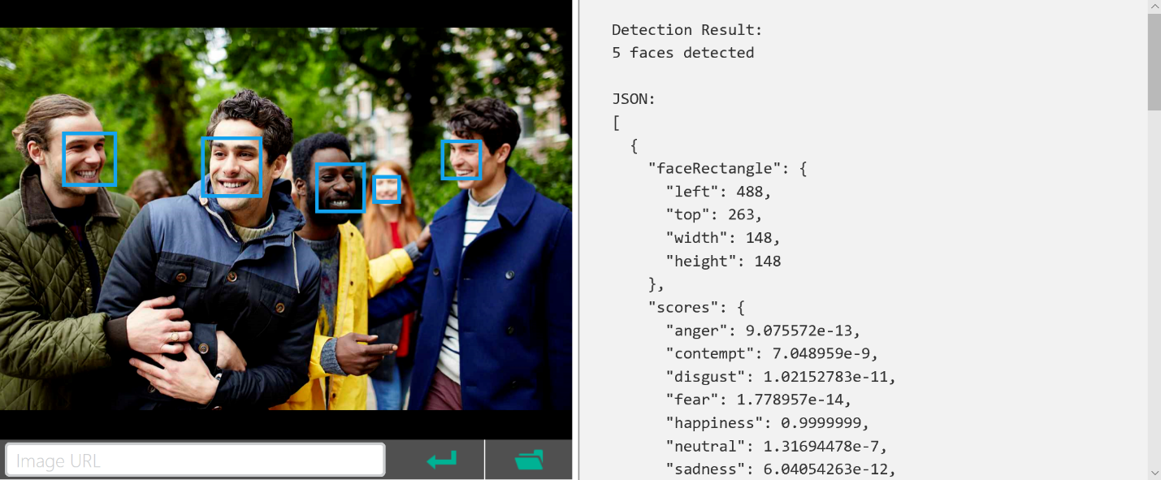
REST/JSON-based Services
Notes:
As you’ve likely gathered, all the results come from the Cognitive services as structured data using JSON. The services themselves are available as REST end-points. This makes it incredibly easy to access the services from any device with a TCP/IP heartbeat and some basic text processing. The data returned is in a logical hierarchy. Often some services do similar things or include the results from one or more other services in which case there’s typically a consistent format for the data used for the same data entities across different calls.

Slide 13
Languages & Runtimes
Any runtime supporting REST calls
Any language that can parse through data
Generally there is a serializer between them – Json.NET or NPM package
Notes:
CLICK – Many runtimes supporting HTTP
As a result of the REST access and JSON format of the data for Cognitive Services, you can use pretty much any runtime that can make an connect to the internet an form an HTTP call. Of course image, audio and video I/O will require appropriate hardware and OS capabilities.
CLICK – Languages
So you could use JavaScript, C#/NET, PHP, node.js, etc
CLICK - Serialization
Typically you will need to do some JSON parsing and this is often made extremely simple by the use of libraries like Json.NET or an NPM packages for node. You could even roll your own quickly for use with basic data parsing.

Slide 14
Demo
Calling Cognitive Services
Notes:
Demo 1.2
Let’s see how easy it is to get going with a call to Cognitive Services…

Slide 15
Getting Started
General free trials
Regular subscriptions managed through Azure
Use Visual Studio to Paste JSON as a class
Must keep keys safe, so do not store in client applications
Notes:
CLICK – Samples and Free Trials
There are interactive sample demos available on the Cognitive Services website which you can use to get a taste for the services. There are also free trials available for many of the services provided a generous quantity of calls to the REST services. This will get you up and running in development very quickly.
CLICK – Full subscriptions on Azure
Once you are underway with your development or ready for production and need to go beyond the free trial quantities, you can subscribe to various levels of services. These are managed through the Azure Portal.
CLICK – Paste JSON
In recent editions of Visual Studio you can easily take JSON copied from the Cognitive Services website and use the ‘Paste JSON as a Class’ feature to instantly create a C# class that can hold serialized JSON.
CLICK – Key safety
You’ll see demos here were we put the keys to services directly into client applications. In practice you would not do this as it would expose your subscription to abuse by unauthorized users. The key would typically be stored in your server based end-point which would proxy calls to the Cognitive Services. You would then likely take steps to authenticate users to your back end.

Slide 16
Scenario – A Researcher
Request a picture of a thing by voice
Determine that this is for a thing
Get image to display
“Show me a picture of a table”
This is about a thing
Image of table
Request a picture of a person (with a specific emotion) by voice
Determine that this is for a person
Get image to display
Find emotions of person in picture
Be told the highest emotion and confidence
“A picture of Satya Nadella happy”
This is about a person
Image of person
Emotional readings
“x% sure that this person is [highest emotion]”
Notes:
So let’s discuss a specific scenario which will use 5 Cognitive Services together!
In this scenario you are a researcher and you want to easily find various images for use in some content you are creating.
CLICK – Image of thing by voice.
To begin with let’s say that we want to be able to name a thing (for example, a car) by voice, then we want to check that we are asking for a picture of a thing, vs. a person, and finally we want to get the image.
CLICK – Outputs from services
So we want to get what was said. We want to know with some confidence that this request was for a thing and then we want to get an image.
CLICK – Image of a person with emotion
As an alternative we also want to be able to ask for an image of a person, perhaps with a specific emotion. We need the system to check our intent to see if we want a person vs. a thing, and then we get the image. Now in this case, we will want to get the emotional context of the image and then the application should speak about the most prominent emotion and tell use how confident it is about that.
CLICK – Outputs from services
So we get the text back, we get confirmation of the intent, we get the image, then the emotion ratings, and then the application speaks the confidence of the highest rated emotion

Slide 17
Demo
Researcher App
Notes:
Demo 1.3
No now let’s see that demo in action

Slide 18
Scenario Services Solution
Request a picture of a thing or person (with a specific emotion) by voice
Determine intent for thing or person
Get image to display
Find emotions of person in picture
Be told the highest emotion and confidence
STT
LUIS
Image Search
Emotion
TTS
“A picture of Satya Nadella happy”
This is x% about a thing/person
Image of person
Emotional readings
“x% sure that this person is [highest emotion]”
Notes:
So let’s summarize the chain of services used.
CLICK – Bing Speech Speech To Text aka Speech Recognition.
This gets us the text of what was spoken and then we pass that to…
CLICK – Language Understanding Intelligent Service (or LUIS)
To get which intent was present and the degree of confidence
CLICK – Bing Image Search
We then search for matching images and we take the first one, and then if the predominant intent was for a person (vs. a thing), we also then pass the image to…
CLICK – Emotion API
Which gives us all the emotion ratings
CLICK – Bing Speech Text to Speech
We find the highest rated emotion and we speak about that
So this is a chaining of 5 Cognitive services and you can see how we could have done parts of it multiple times with multiple images instead of just one.

Slide 19


Starship Commander
A VR game with interactive character experiences powered by voice where player actions determine story.
Used Custom Speech Service allowing for fictional names and phrases, and training custom script.
Overcame barriers around speaking style, background noise & vocabulary – cut error rate in half.
Service is available for future platform expansion
Players speak their mind, so LUIS helps determine their intent
Notes:
Let’s take a look at Starship Commander by Human Interact
CLICK – Interactive VR game powered by voice
They built an interactive VR game, but they wanted to immerse the player even further than just using a controller, by allowing interactions by voice
CLICK – Custom Speech Service
They used the Custom Speech Service to not only get Voice Recognition but, by providing models for key fictional names, objects and phrases, they got accurate recognition approach to the context of their game and the players using it.
CLICK – Acoustic models and increase accuracy
With the addition of acoustic models, to suit the frenetic pattern of game play and headsets, they cut their error rate in half.
CLICK – Cloud service future-ready
Because they use this service in the cloud, they can easily re-use it as part of having the game work on other platforms.
CLICK – LUIS for natural use
They also added in LUIS so they could accept more natural language and extract the intent of the player using the power of trained machine learning, rather than trying to parse text directly.

Slide 20
Summary
Explored services that bring structured semantic data to human I/O with a degree of confidence
Saw examples of companies using these services
Learned the basics of getting connected
Saw an example of multiple services working together for a specific scenario
Notes:
CLICK – structure semantics from human I/O
So we’ve explored Cognitive Services that provide (or use) structure semantic data to human I/O while also providing the degree of confidence in the semantic interpretation.
CLICK – Real deeply integrated commercial/gaming use
We saw examples of companies using these services deeply at the core of what they do.
CLICK – Exploring more
We saw where you can find out more and how easy it is to get started from almost any platform.
CLICK – Chaining services example
With the Research scenario, we saw how you get to use multiple services chained together to automate a process and provide some real value when building content.

Slide 21
Resources
Further sessions in this series:
Starting Cognitive Services – The building blocks and services behind the Research app
Learn and try at - https://www.microsoft.com/cognitive-services
Docs & getting started - https://docs.microsoft.com/en-us/azure/cognitive-services/
Cognitive Services example code - https://github.com/Microsoft/Cognitive-Samples-IntelligentKiosk
Notes:
As shown

